Slide 1
Developing a NIOS II System

Slide 2
SOPC Builder
An SOPC Builder is a System on a Programmable Chip Builder. This software, made by Altera, makes it easier for users to simulate hardware components, like the processor and memory, in order to design a computer system.

Slide 3
First, What is Needed?
A program able to create programmable code for the computer system. The program available to use for free is the..
Quartus 12.1 Web Edition
Also needed is a processor board. Available is the DE2 board; an FPGA system (Cyclone IV GX FPGA System). The programmed code will be programmed to this board by using Quartus and USB cable.

Slide 4
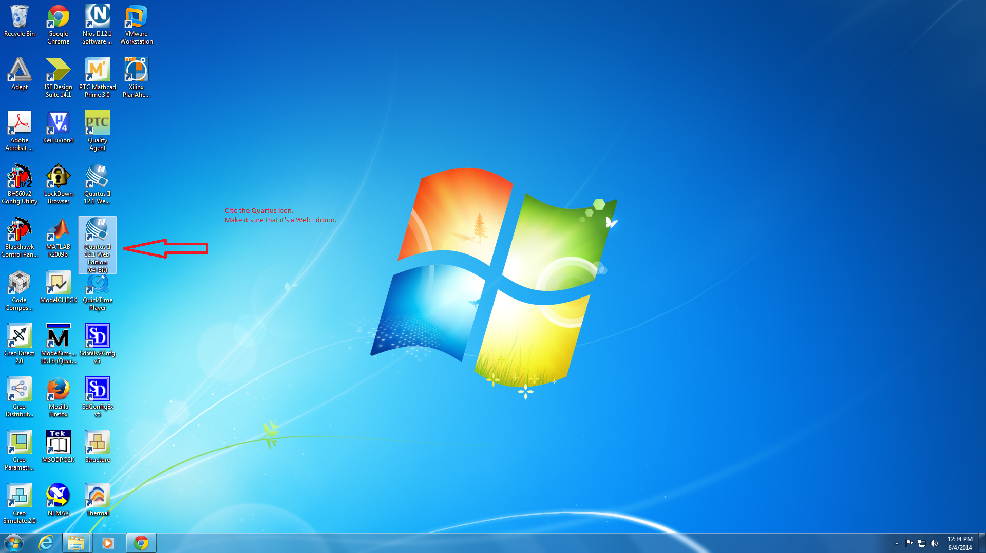
Getting Started: Quartus 12.1 Web Edition

Slide 5
At the Start of Quartus
Once the program Quartus 12.1 Web Edition is open, you will have the option of creating a new project or opening an existing project. If you are creating a new one, then you would select Create a New Project.
Naming the Project: Top Level Hierarchy
After selecting to create a new project, it will prompt you to create a directory (folder) on the hard drive of the computer you are using to save your work. It will ask you for the name of the project, and also the name of the top level design entity. The name for the top-level design entity is case sensitive and must exactly match the entity name in the design file. This way, all coding can lead back to the directory where the project is being saved at. This is also the importance of hierarchy; for organized, and proper linkage between data saved in the project.

Slide 6
Select Type of Device Used
After setting up your top-level hierarchy, the device being used must be selected so that the program(Quartus) can properly setup the programmed code for programming into the device. Available as was said is the Cyclone IV GX FPGA System. Selecting that as your device to be used, it is also important to note the model type name of the DE2 board for having the exact device selected.
E.g. Name : EPCGX150DF31C7
The next set of options is a list of EDA Tool settings, which are not all that important to change, unless there is specific circumstances taken into account with the DE2 board used.

Slide 7
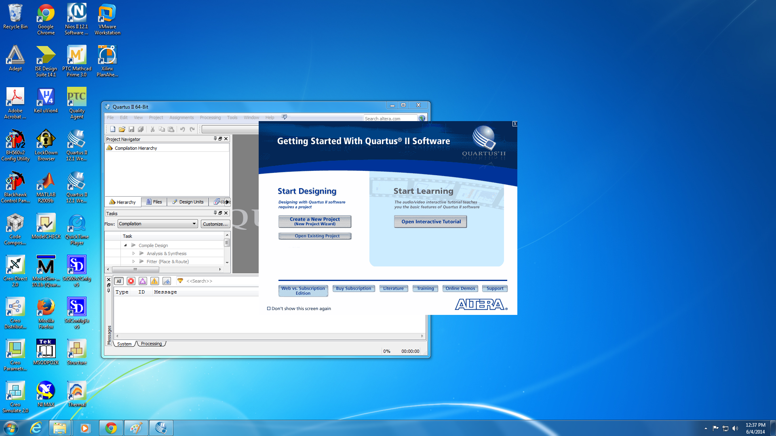
Create a new project

Slide 8
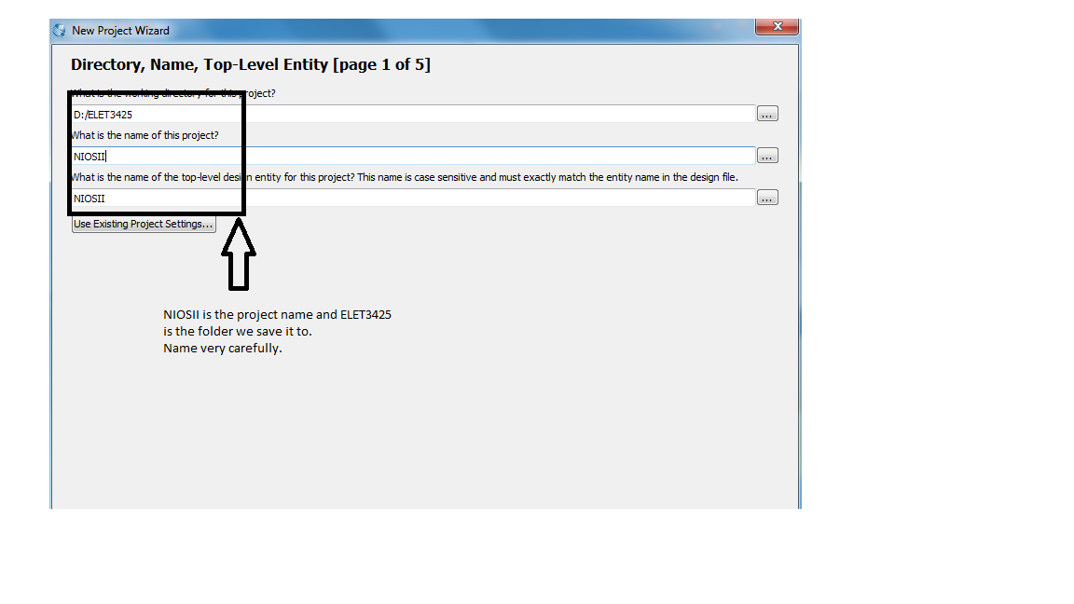
Naming the project: Top Level Hierarchy

Slide 9
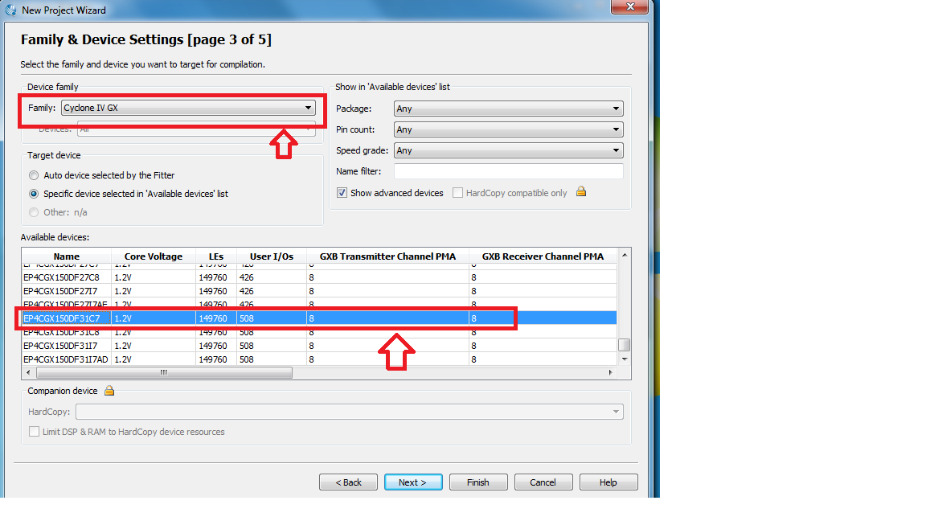
Selecting Device

Slide 10
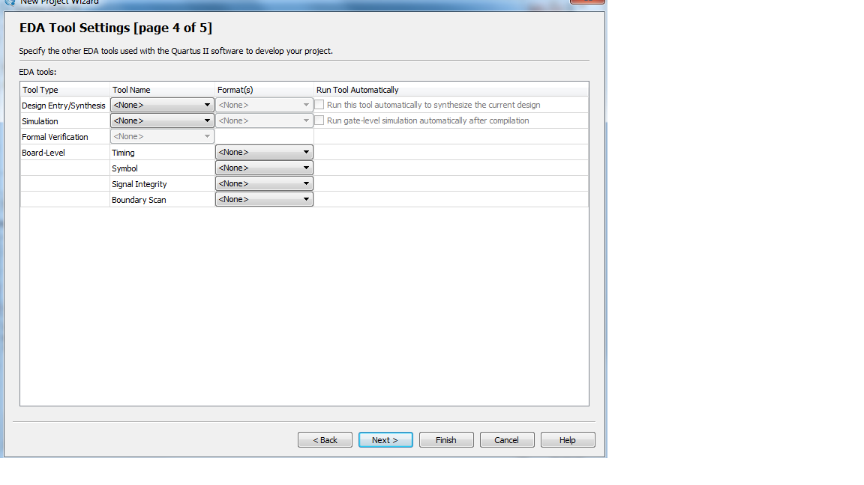
Continued…..

Slide 11
Setting up the SOPC Builder
After the setup of your project is complete, setting up the SOPC builder is the next task. This option is found under Tools > SOPC Builder
This is the configuration needed to properly design programmed code for processor and NIOS II system.
Once there, it will ask for the System name, and Target HDL.

Slide 12
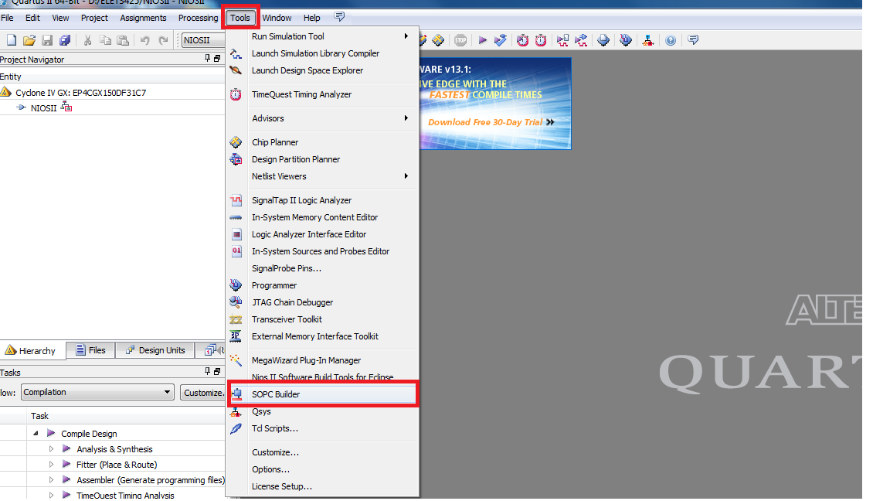
SOPC Begins… Tools----→ SOPC Builder

Slide 13
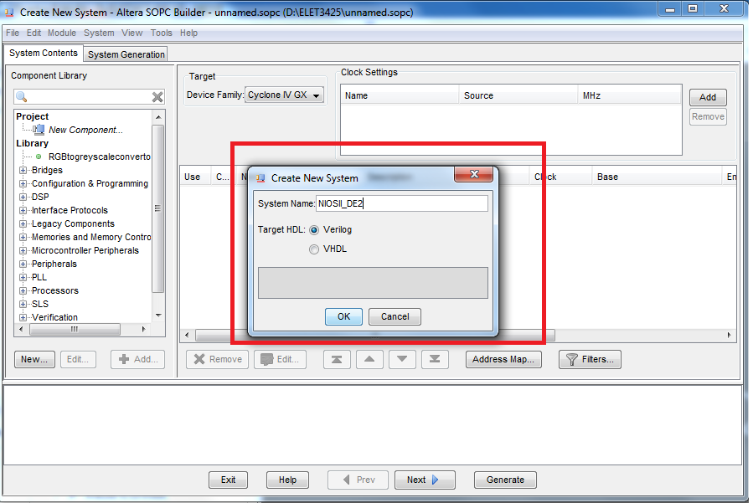
SOPCINFO file, Name it NIOSII_DE2

Slide 14
HDL
HDL (Hardware Description Language) is a specialized computer language used to program the structure, design and operation of electronic systems; in this case, an FPGA system.
DIFFERENCE BETWEEN VERILOG and VHDL:
VHDL(Very high speed integrated circuit Hardware Description Language):
This is a strongly typed language, and scripts that are not strongly typed, are unable to compile. A strongly typed language like VHDL does not allow the intermixing, or operation of variables, with different classes. VHDL is not case sensitive, and users can freely change the case, as long as the characters in the name, and the order, stay the same.
VERILOG
Verilog uses weak typing, which is the opposite of a strongly typed language. Verilog is case sensitive, and would not recognize a variable if the case used is not consistent with what it was previously. But the advantage that Verilog has over the older language VHDL, is the fact that since the coding is very similar to the popular C programming, then this is much more preferred. Selecting this option under Target HDL is better for beginners.

Slide 15
Check the Processor Settings
Check the NIOS II Processor under Processors, and check to see if the right Device Family is selected, and the clock settings are set correctly. If not, they can be edited.

Slide 16
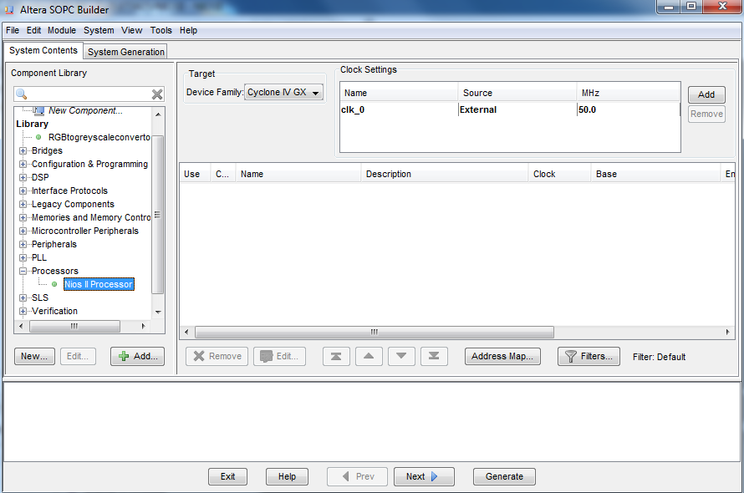
Check the Processor Settings

Slide 17
Selecting a NIOS II Core
You will be prompted to select a NIOS II Core for the project.
Three options are available, NIOS II/e, NIOS II/s, NIOS II/f
Below are the major features between all the processors:
Performance: 50MHz
Logic and Memory Usage
DMIPS (Dhrystone Millions Per Second) is the units for the performance, More is better.
Logic Usage is the number of logic elements that can be used. Logic elements are electronic devices that perform elementary logic operation. More is generally better.
Memory Usage is the amount of Memory available to be used. E.g. M9K is 9000 bits. The board to be used will be 9216 bits to be exact. More is generally better.

Slide 18
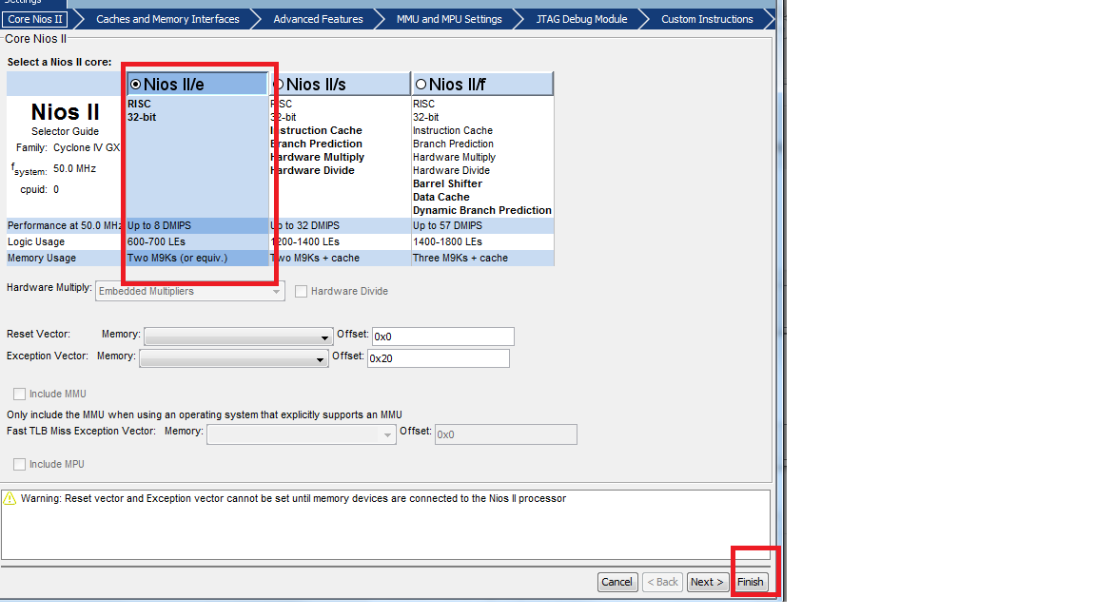
Selecting a NIOS II Core
And the one to be selected is…..
HUHHH? Why? Even though NIOS II/f and NIOS II/s is better, they are not available to use in the free Web Edition of Quartus software. :-P

Slide 19
I/Os
Under Peripherals > Microcontroller Peripherals is PIO(Parallel I/O)
Parallel Input/Output data is desired for the transfer between data in the system, for if it were Serial I/O, then each part of data inputted or outputted would depend on the previous data. If the previous data is corrupt, missing, etc., then the final data will be incorrect
Parallel I/O allows for independent transfer of data; stand alones; no need to have direct dependence on the previous data.
The size of the bits allocated for Parallel I/Os can be set also. Available will be from 1- 32 bits. However, for beginners, 8 bits is very sufficient.

Slide 20
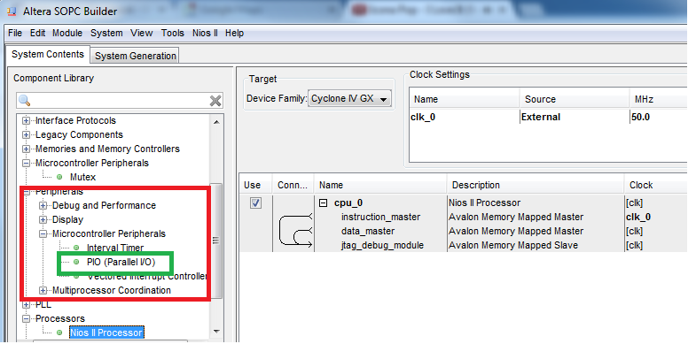
I/Os

Slide 21
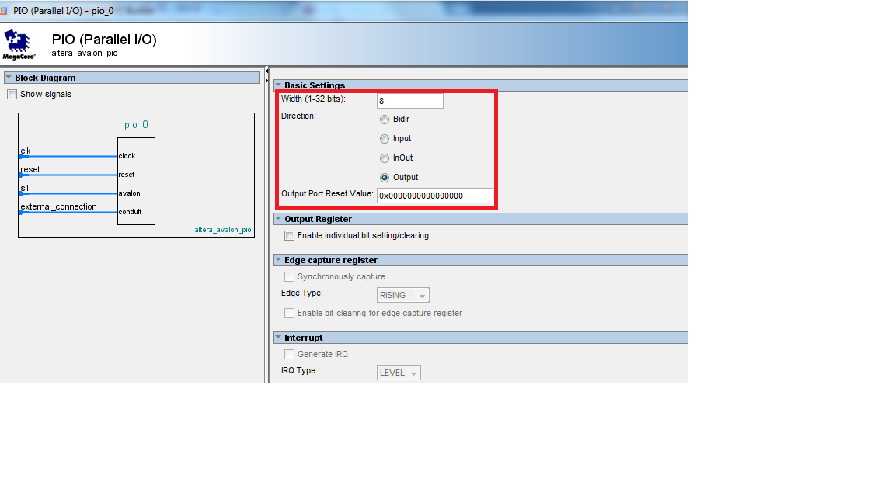
I/Os

Slide 22
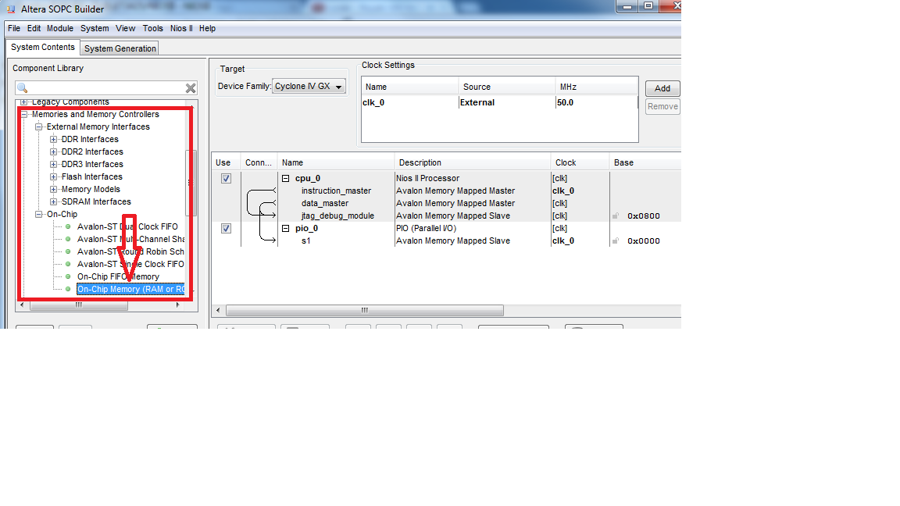
Chip Memory
Checking these settings here under memory is important to configure also. These settings are preferred.

Slide 23
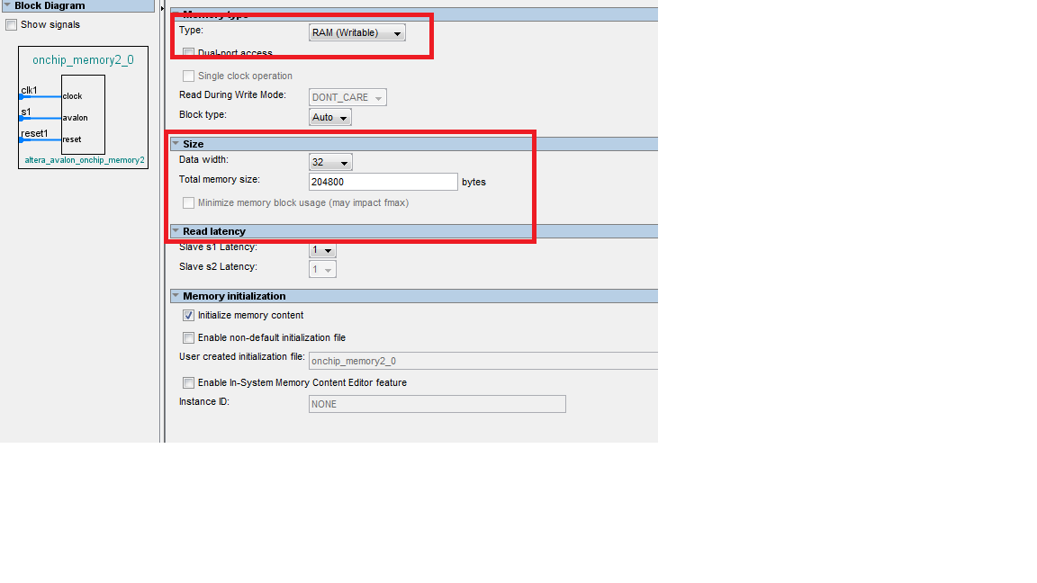
Chip Memory
These are the preferred settings. RAM (Writable) is selected since we are programming code into system. Data width is 32 bits, which is sufficient. 204800 bytes is important to set as the total memory size for beginners projects on the Cyclone IV GX FPGA System, since previous projects have had problems with lower and higher values.

Slide 24
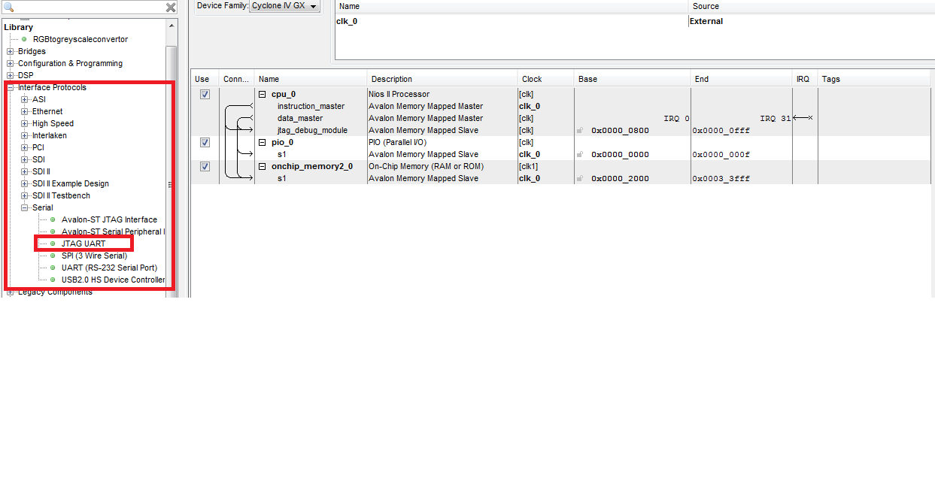
Setting Up the Interface

Slide 25
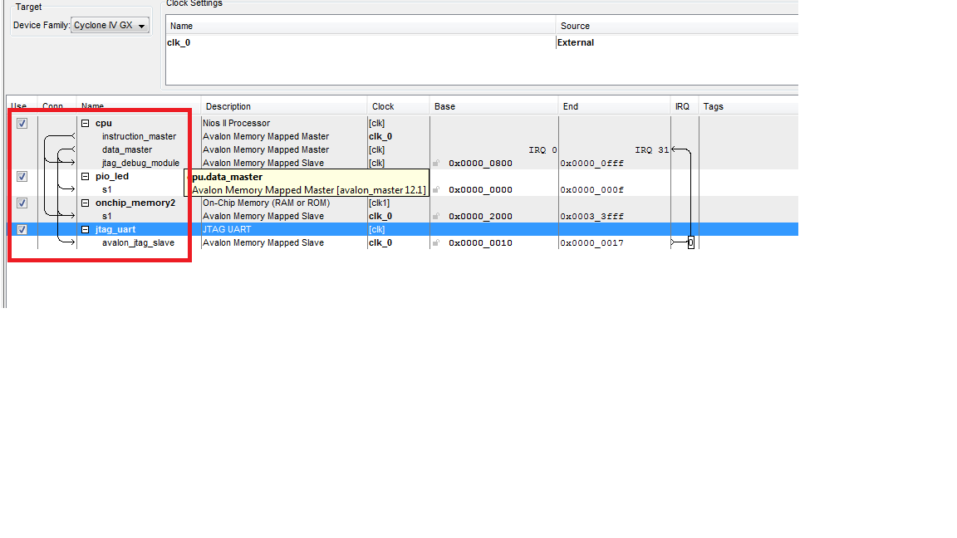
Setting Up Interface cont’d

Slide 26
Interfacing: JTAG UART
JTAG – Joint Test Action Group
This is a set of test ports that is used for debugging but can also be used to program firmware.
UART - Universal Asynchronous Receiver/Transmitter
This is a type of chip that controls communications to and from a device, such as a microcontroller, ROM, RAM, etc. Most of the time, it's a serial connection that allows us to communication to a device.

Slide 27
Interfacing: The JTAG UART Core
In many designs, the JTAG UART core eliminates the need for a separate RS-232 serial connection to a host PC for character I/O.
The core provides a simple register-mapped Avalon interface that hides the complexities of the JTAG interface from embedded software programmers.
Master peripherals (such as a Nios®II processor) communicate with the core by reading and writing control and data registers. The JTAG UART core uses the JTAG circuitry built in to Altera FPGAs, and provides host access via the JTAG pins on the FPGA.
The host PC can connect to the FPGA via any Altera JTAG download cable, such as the USB-Blaster™ cable.

Slide 28
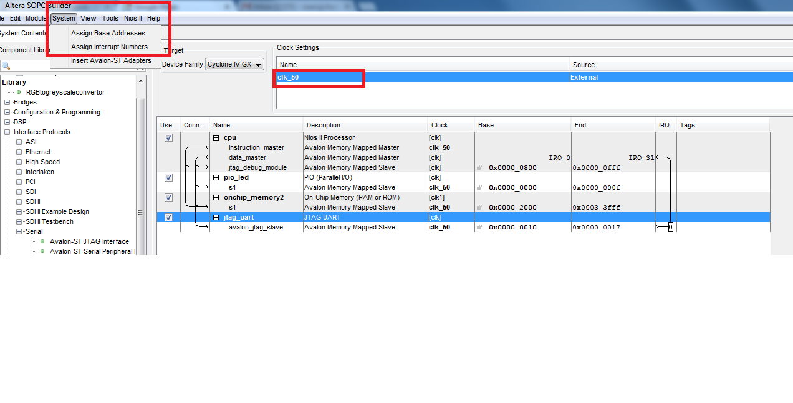
Assigning Addresses
The Addresses can be assigned to all slave interfaces/ports in the SOPC Builder, making system avoid conflicts for all memory- mapped component interfaces.

Slide 29
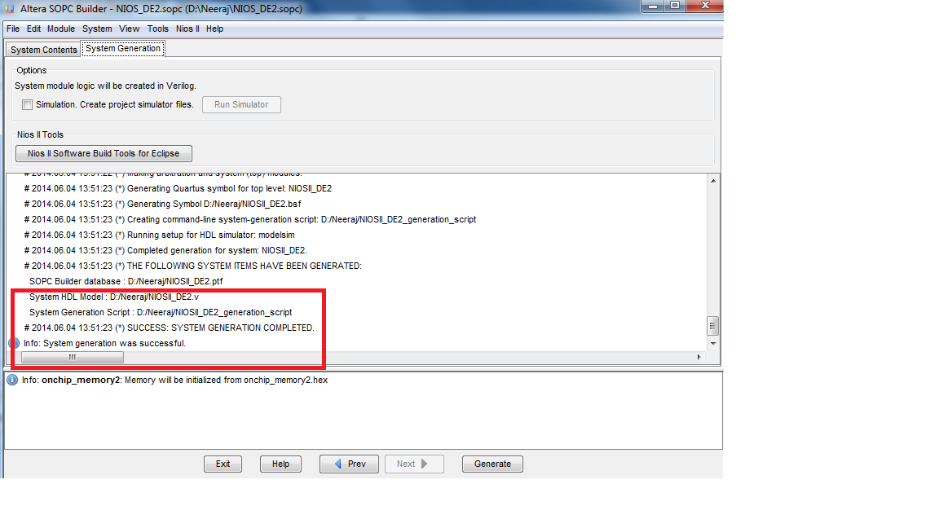
FINALLY, Generate the SOPC Builder

Slide 30
CONGRATS!! Your SOPC Builder is Ready to be Programmed to Your Board!

